Slide 1
RATHEESH M
Final Project
3/21/2024 Annual Review

Slide 2
ACCIDENT DETECTION USING YOLO
3/21/2024 Annual Review

Slide 3


AGENDA
Introduction
Welcome & Agenda Overview
The Power of YOLO
Real-Time Object Detection Excellence
Unveiling Our Solution
Cutting-Edge Accident Detection
Value Proposition
Lightning-Fast Response
Precision and Accuracy
Seamless Integration
Empowered Decision-Making
Implementation Strategies
From Concept to Deployment
3/21/2024 Annual Review

Slide 4

PROBLEM STATEMENT
Road accidents are a major problem in India, with thousands of people losing their lives and many more suffering serious injuries every year.
According to the Ministry of Road Transport and Highways, India witnessed around 4.5 lakh road accidents in 2019, which resulted in the deaths of more than 1.5 lakh people.
The age range that is most severely hit by road accidents is 18 to 45 years old, which accounts for almost 67 percent of all accidental deaths.
3/21/2024 Annual Review

Slide 5

PROJECT OVERVIEW
We are using Yolov8 to train our custom dataset which has been 3200+ images, collected from different platforms.
This model after training with 25 iterations and is ready to detect an accident with a significant probability.
Accident Detection Model is made using YOLOv8, Google Collab, Python, Roboflow, Deep Learning, OpenCV, Machine Learning, Artificial Intelligence.
It can detect an accident on any accident by live camera, image or video provided. This model is trained on a dataset of 3200+ images, These images were annotated on roboflow.
3/21/2024 Annual Review

Slide 6

WHO ARE THE END USERS?
Transportation Authorities
Law Enforcement Agencies
Emergency Services
Vehicle Manufacturers
Fleet Operators
City Planners and Urban Developers
Insurance Companies
3/21/2024 Annual Review

Slide 7

YOUR SOLUTION AND ITS VALUE PROPOSITION
Solution: Accident Detection System Using YOLO
Overview: Our system employs YOLO for real-time accident detection using camera feeds. It integrates seamlessly with existing infrastructure and offers a user-friendly interface for efficient monitoring.
Value Proposition:
Enhanced Safety: Swift accident detection leads to faster responses, reducing injuries and saving lives.
Optimized Resource Allocation: Efficient deployment of emergency services improves response times.
Data-Driven Insights: Generates actionable data for evidence-based decision-making.
Scalability and Adaptability: Customizable for various environments, ensuring broad applicability and impact.
3/21/2024 Annual Review

Slide 8

THE WOW IN YOUR SOLUTION
Lightning-Fast Response: YOLO enables near-instantaneous accident detection, shaving precious seconds off emergency response times.
Precision and Accuracy: Our system boasts unparalleled accuracy, minimizing false alarms and maximizing efficiency.
Seamless Integration: With seamless integration into existing infrastructure, implementation is smooth and hassle-free.
Empowered Decision-Making: Actionable insights derived from our data empower stakeholders to make informed decisions, ultimately enhancing safety on roads and in industrial settings.
3/21/2024 Annual Review
8

Slide 9
MODELLING
Preparing Custom dataset
We have collected 1200+ images from different sources like YouTube, Google images, Kaggle.com etc.
Then we annotated all of them individually on a tool called roboflow.
During Annotation we marked the images with no accident as NULL and we drew a box on the site of accident on the images having an accident
Then we divided the data set into train, val, test in the ratio of 8:1:1
At the final step we downloaded the dataset in yolov8 format.
3/21/2024 Annual Review
9

Slide 10
MODELLING
Using Google Collab
We are using google colaboratory to code this model because google collab uses gpu which is faster than local environments.
You can use Jupyter notebooks, which let you blend code, text, and visualisations in a single document, to write and run Python code using Google Colab.
Users can run individual code cells in Jupyter Notebooks and quickly view the results, which is helpful for experimenting and debugging. Additionally, they enable the development of visualisations that make use of well-known frameworks like Matplotlib, Seaborn, and Plotly.
In Google collab, First of all we Changed runtime from TPU to GPU.
We cross checked it by running command ‘!nvidia-smi’
3/21/2024 Annual Review
10

Slide 11
MODELLING
Coding
First of all, We installed Yolov8 by the command ‘!pip install ultralytics==8.0.20’
Further we checked about Yolov8 by the command ‘from ultralytics import YOLO from IPython.display import display, Image’
Then we connected and mounted our google drive account by the code ‘from google.colab import drive drive.mount('/content/drive')’
Then we ran our main command to run the training process ‘%cd /content/drive/MyDrive/Accident Detection model !yolo task=detect mode=train model=yolov8s.pt data= data.yaml epochs=1 imgsz=640 plots=True’
After the training we ran command to test and validate our model ‘!yolo task=detect mode=val model=runs/detect/train/weights/best.pt data=data.yaml’ ‘!yolo task=detect mode=predict model=runs/detect/train/weights/best.pt conf=0.25 source=data/test/images’
3/21/2024 Annual Review
11

Slide 12
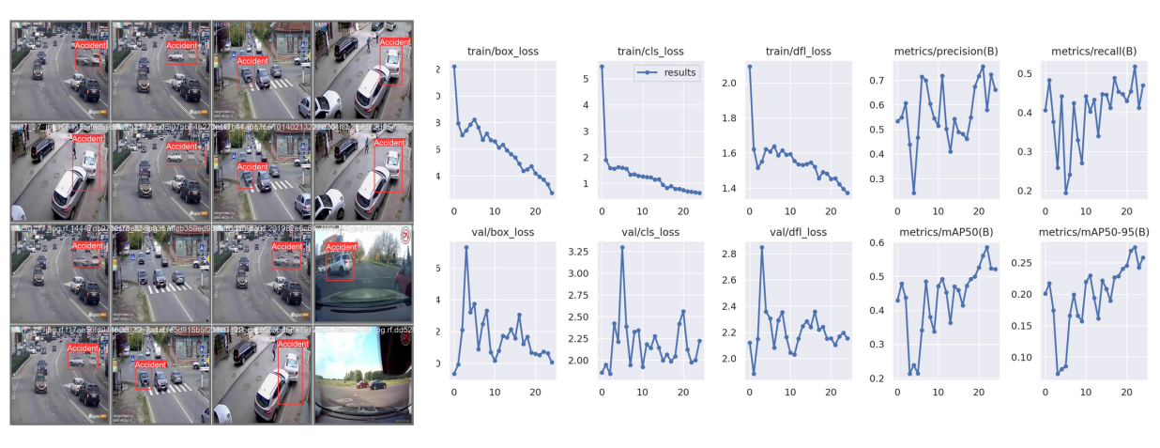
RESULTS
Accident detection demo.mp4 is Live accident detection on a video by this model
Results generated by the model after training are -
Demo Link: https://github.com/shubhankar-shandilya-india/Accident-Detection-Model/blob/master/README.md#coding
3/21/2024 Annual Review
12

